Slide 1
JAVA MEMORY MANAGEMENT Part 1
Presenter: Davoud Badamchi
Presentation Date: 08/20/2019

Slide 2
Why memory is important?
When application runs it need memory.
JVM is so complicated.
We don’t need to go into nitty-gritty of it.
But if you know how JVM works it can help you understand some basic concepts which helps you to write optimize code.
You will avoid Coding Errors

Slide 3

JAVA Memory
Stack
Heap
Stack memory
FILO (First In Last Out)
Every thread has its own stack memory, to maintain the threads data.

Slide 4
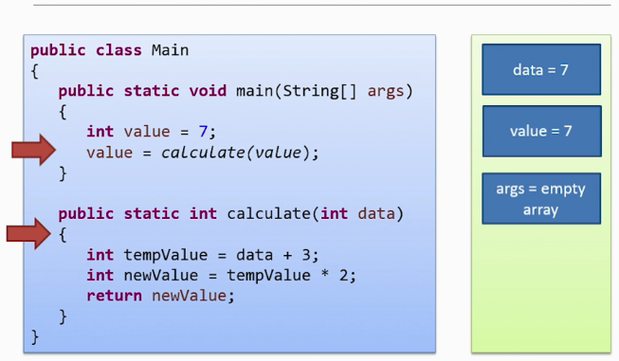

Slide 5
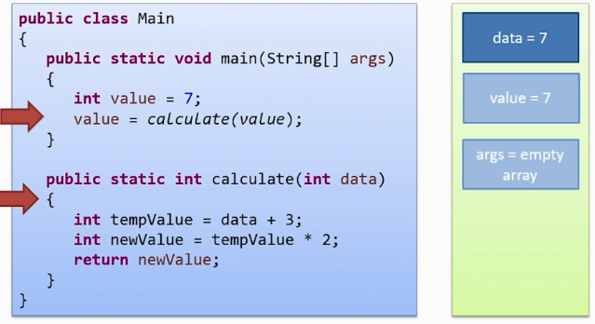

Slide 6
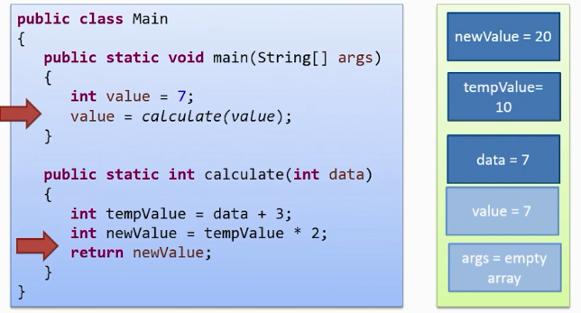

Slide 7
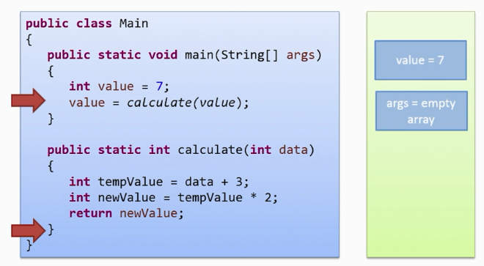

Slide 8
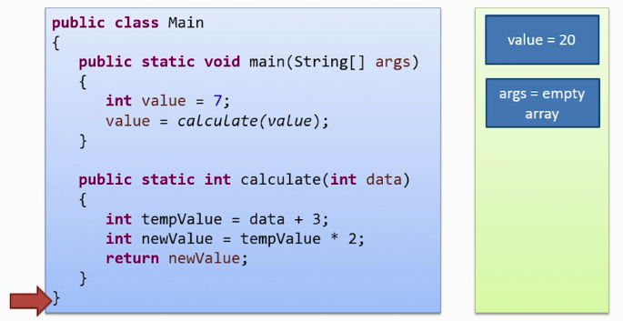

Slide 9
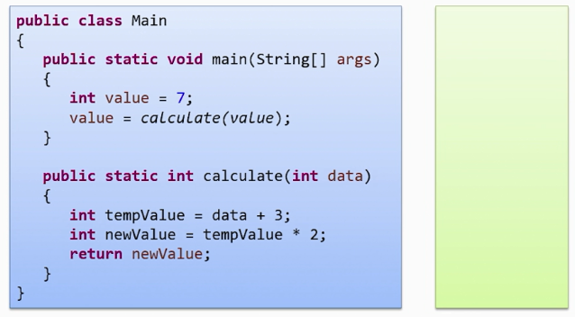

Slide 10
We as a developer don’t care what happens in stack, but help us to understand variable scopes.
Data in each stack is owned and be seen by its relevant thread.

Slide 11
Heap memory
Has much larger space
Objects are stored in heap that has longer life-time
You can think of it as all the memory for your application except data need to be stored in stack.
There is only one heap which shares across all threads.
Stack is for local primitive variables

Slide 12
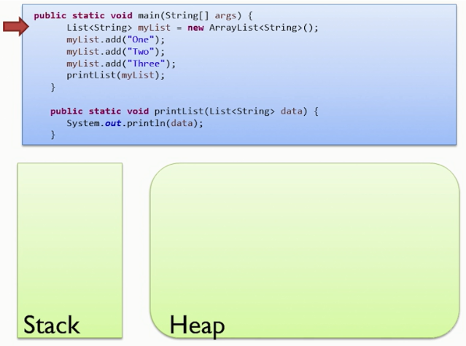
Sharing data

Slide 13
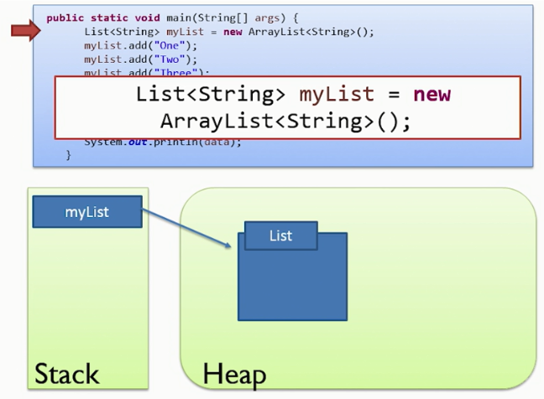
Sharing data

Slide 14
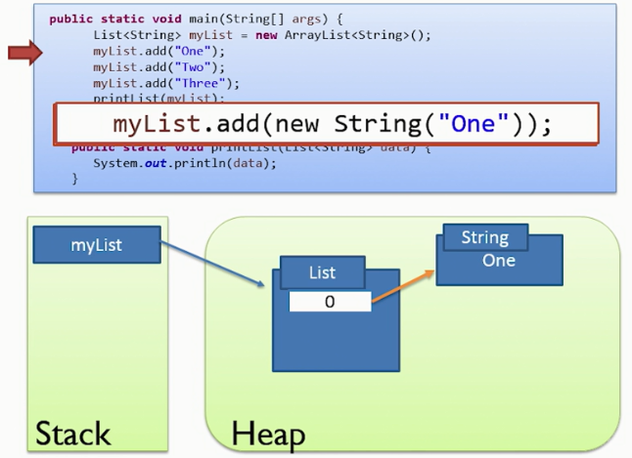
Sharing data

Slide 15
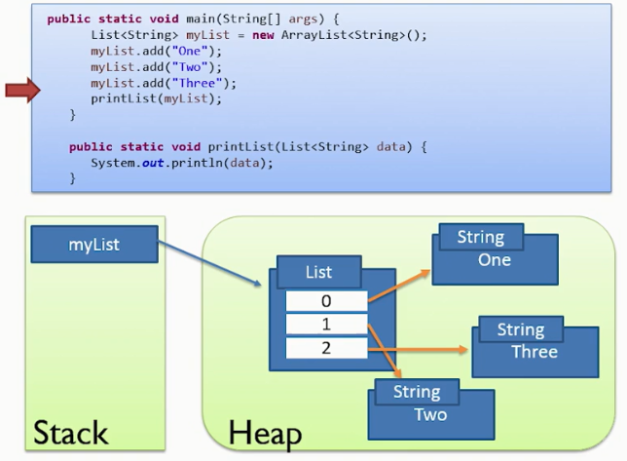
Sharing data

Slide 16
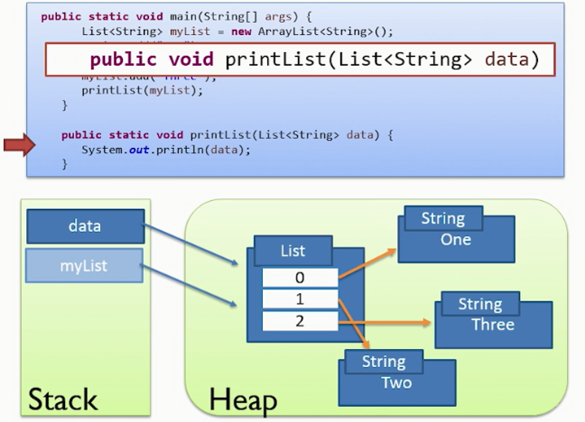
Sharing data

Slide 17
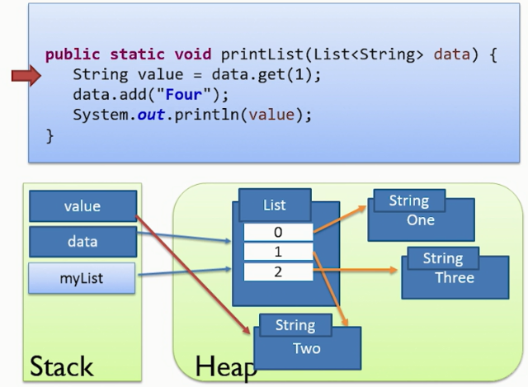
Sharing data

Slide 18
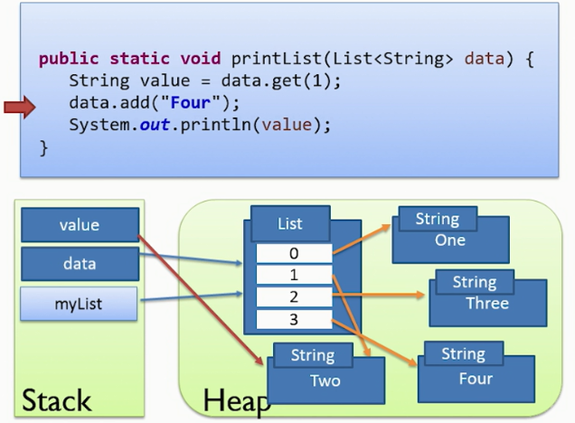
Sharing data

Slide 19
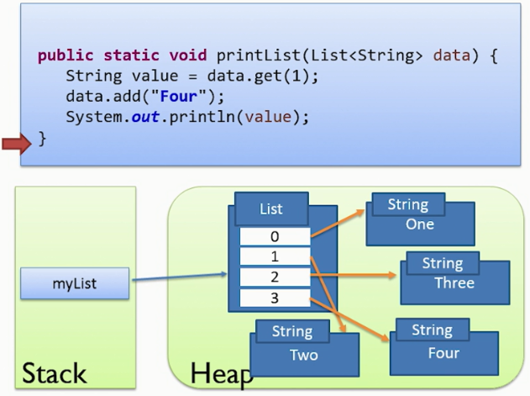
Sharing data

Slide 20
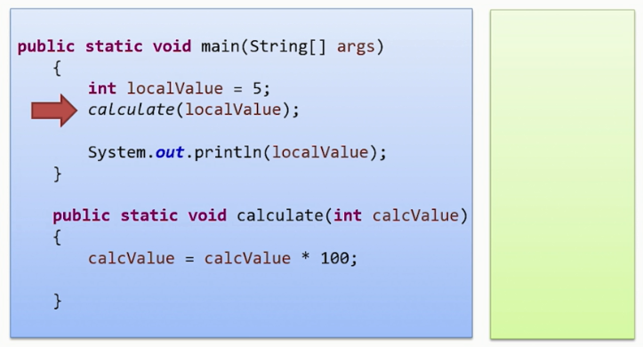
Passing variable by value
What is the result of this code snippet?

Slide 21
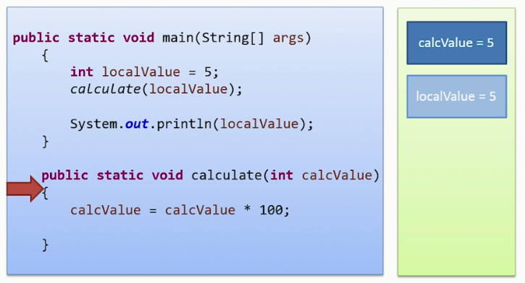
Passing variable by value

Slide 22
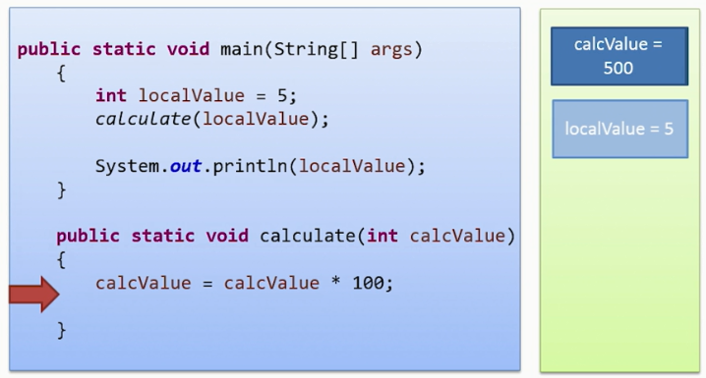
Passing variable by value

Slide 23
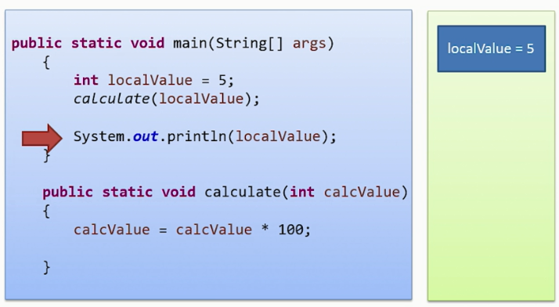
Passing variable by value
Final result is 5.

Slide 24
Passing by reference (not possible!)
In Java we do not have pass by reference
Passing objects to method, we actually copy the reference variable content in the stack

Slide 25
Example of pass by reference
public static void main(String[] args) {
Dog aDog = new Dog("Max");
Dog oldDog = aDog;
// we pass the object to foo
foo(aDog);
// aDog variable is still pointing to the "Max" dog when foo(...) returns
aDog.getName().equals("Max"); // true
aDog.getName().equals("Fifi"); // false
aDog == oldDog; // true
}
public static void foo(Dog d) {
d.getName().equals("Max"); // true
// change d inside of foo() to point to a new Dog instance "Fifi"
d = new Dog("Fifi");
d.getName().equals("Fifi"); // true
}
In this example aDog.getName() will still return "Max". The value aDog within main is not changed in the function foo with the Dog "Fifi" as the object reference is passed by value. If it were passed by reference, then the aDog.getName() in main would return "Fifi" after the call to foo.

Slide 26
public static void main(String[] args) {
Dog aDog = new Dog("Max");
Dog oldDog = aDog;
foo(aDog);
// when foo(...) returns, the name of the dog has been changed to "Fifi"
aDog.getName().equals("Fifi"); // true
// but it is still the same dog:
aDog == oldDog; // true
}
public static void foo(Dog d) {
d.getName().equals("Max"); // true
// this changes the name of d to be "Fifi"
d.setName("Fifi");
}
Example of passing by reference
In this example, Fifi is the dog's name after call to foo(aDog) because the object's name was set inside of foo(...). Any operations that foo performs on d are such that, for all practical purposes, they are performed on aDog, but it is not possible to change the value of the variable aDog itself.

Slide 27
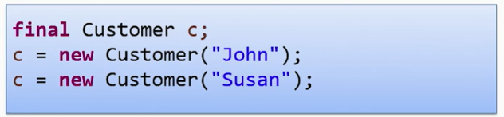
The final keyword
What is the problem of this code?
Compile error

Slide 28
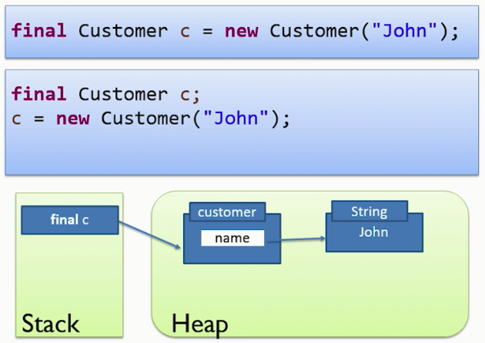
The final keyword

Slide 29
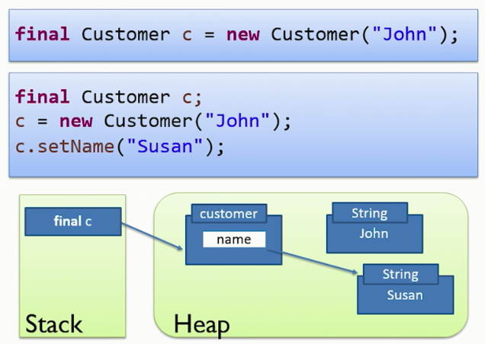
The final keyword

Slide 30
Const Correctness
In some languages there is keyword “const” and you can not change objects internal fields as well, this is called Const Correctness.
In Java this is not supported and developers must care where a method accepts object as parameter.
In Java the only thing that cannot be changed is the reference that is pointing to the object in heap.

Slide 31
public class Main {
public static void main(String args[]) {
new Main().start();
}
public void start() {
String last = "Z";
Container container = new Container();
container.setInitial("C");
another(container,last);
System.out.print(container.getInitial());
}
public void another(Container initialHolder, String newInitial) {
newInitial.toLowerCase();
initialHolder.setInitial("B");
Container initial2 = new Container();
initialHolder=initial2;
System.out.print(initialHolder.getInitial());
System.out.print(newInitial);
}}
public class Container {
private String initial = "A";
public String getInitial() {
return initial;
}
public void setInitial(String initial) {
this.initial = initial;
}
}

